Slide 1


Slide 2


Darkness Lesson 4 Eyes Full of Adultery: False Teachers

Slide 3
2 Peter 2:1-22
But there were false prophets also among the people, even as there shall be false teachers among you, who privily shall bring in damnable heresies, even denying the Lord that bought them, and bring upon themselves swift destruction. 2 And many shall follow their pernicious ways; by reason of whom the way of truth shall be evil spoken of. 3 And through covetousness shall they with feigned words make merchandise of you: whose judgment now of a long time lingereth not, and their damnation slumbereth not.

Slide 4
2 Peter 2:1-22
4 For if God spared not the angels that sinned, but cast them down to hell, and delivered them into chains of darkness, to be reserved unto judgment; 5 And spared not the old world, but saved Noah the eighth person, a preacher of righteousness, bringing in the flood upon the world of the ungodly; 6 And turning the cities of Sodom and Gomorrha into ashes condemned them with an overthrow, making them an ensample unto those that after should live ungodly; 7 And delivered just Lot, vexed with the filthy conversation of the wicked: 8 (For that righteous man dwelling among them, in seeing and hearing, vexed his righteous soul from day to day with their unlawful deeds;)

Slide 5
2 Peter 2:1-22
9 The Lord knoweth how to deliver the godly out of temptations, and to reserve the unjust unto the day of judgment to be punished: 10 But chiefly them that walk after the flesh in the lust of uncleanness, and despise government. Presumptuous are they, selfwilled, they are not afraid to speak evil of dignities. 11 Whereas angels, which are greater in power and might, bring not railing accusation against them before the Lord. 12 But these, as natural brute beasts, made to be taken and destroyed, speak evil of the things that they understand not; and shall utterly perish in their own corruption;

Slide 6
2 Peter 2:1-22
13 And shall receive the reward of unrighteousness, as they that count it pleasure to riot in the day time. Spots they are and blemishes, sporting themselves with their own deceivings while they feast with you; 14 Having eyes full of adultery, and that cannot cease from sin; beguiling unstable souls: an heart they have exercised with covetous practices; cursed children: 15 Which have forsaken the right way, and are gone astray, following the way of Balaam the son of Bosor, who loved the wages of unrighteousness; 16 But was rebuked for his iniquity: the dumb ass speaking with man's voice forbad the madness of the prophet.

Slide 7
2 Peter 2:1-22
17 These are wells without water, clouds that are carried with a tempest; to whom the mist of darkness is reserved for ever. 18 For when they speak great swelling words of vanity, they allure through the lusts of the flesh, through much wantonness, those that were clean escaped from them who live in error. 19 While they promise them liberty, they themselves are the servants of corruption: for of whom a man is overcome, of the same is he brought in bondage. 20 For if after they have escaped the pollutions of the world through the knowledge of the Lord and Saviour Jesus Christ, they are again entangled therein, and overcome, the latter end is worse with them than the beginning. 21 For it had been better for them not to have known the way of righteousness, than, after they have known it, to turn from the holy commandment delivered unto them. 22 But it is happened unto them according to the true proverb, The dog is turned to his own vomit again; and the sow that was washed to her wallowing in the mire.

Slide 8
Introduction
In the first part of 2 Peter 2, Peter points out just as there were false prophets, there would be false teachers. He links these two.
Prophets were messengers of God through direct inspiration, while teachers are messengers of God's word through the inspired scriptures.
Since Romans 15:4 instructs that the Old Testament was written for our learning, students of God's word might consider false prophets in the Old testament in thinking about false teachers.

Slide 9

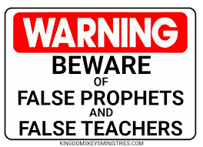
False Prophets and False Teachers
In Deuteronomy 18:9-22 Moses discuss false prophets who seek the invisible of God without divine revelation.
Moses calls these diviners "an abomination unto the Lord." Moses continues to contrast the false prophets who claimed knowledge they did not have because it did not come to pass.
Later, the nation of Israel persecuted the true prophets because they did not want to hear the word of God (Mt 5:12ff).

Slide 10
False Prophets and False Teachers
As God has used teachers and prophets, there have been false ones.
Jeremiah complained about false prophets in Jeremiah 5:31, "The prophets prophesy falsely, and the priests bear rule by their means; and my people love to have it so: and what will ye do in the end thereof?"
Similarly, Paul had to deal with those who bound the Old Law in Acts 15:1-2.
In the same way, Jesus foretold there would be false prophets in Matthew 24:9-11. Lastly, Peter warns the church in 2:1-3 of his second epistle that false teachers will exist among brethren.

Slide 11
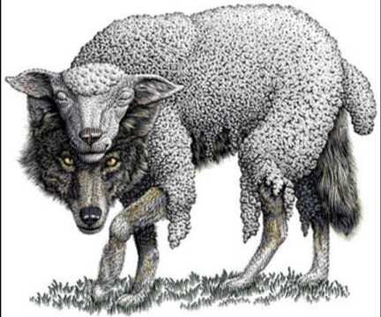
False Prophets and False Teachers
Today, children of God still live in a time of false teachers.
In Matthew 7:15, Jesus warns "Beware of false prophets, which come to you in sheep's clothing, but inwardly they are ravening wolves."

Slide 12
False Prophets and False Teachers
Likewise, Paul warned the elders at Ephesus in Acts 20:29-30, "For I know this, that after my departing shall grievous wolves enter in among you, not sparing the flock. 30 Also of your own selves shall men arise, speaking perverse things, to draw away disciples after them."
2 Timothy 4:3-4 further explains, "For the time will come when they will not endure sound doctrine; but after their own lusts shall they heap to themselves teachers, having itching ears;4 And they shall turn away their ears from the truth, and shall be turned unto fables."
Yes, people will seek to answer their lust rather than endure sound doctrine.
The nation of Israel did not want to hear God's prophets so they sought false prophets and persecuted God's prophets.

Slide 13
False Prophets and False Teachers
The key difference between a prophet and teacher is the origin of the source.
Prophets are inspired by God to speak for Him.
Teachers instruct others in God's word.
The false prophet is one who is not speaking for God because his words do not match the truth of God's word (Deuteronomy 13:1-4).
Likewise, false teachers can be recognized by false doctrine, but not all false teachers teach false doctrine.
For example, in Jeremiah 14:14-15. Prophets were prophesying in God's name when He had not sent them.
In Philippians 1:15-17, there were those who preached Christ from impure motives.
False teachers are not those who because of lack of understanding or immaturity need correction as Apollos illustrates in Acts 18:24-28, but those who keep to their error when corrected.
False teachers act out of impure motivations.

Slide 14
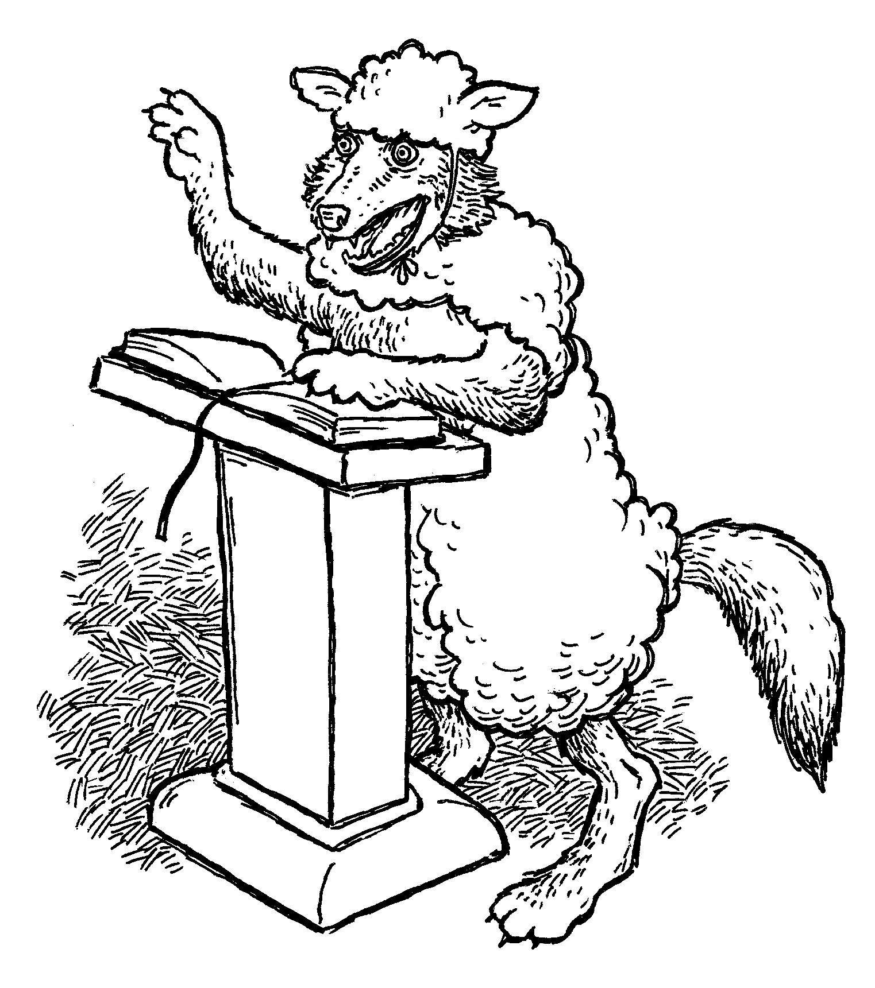
Motivations of False Teachers
False teachers often act out of popularity and power, saying whatever gains them an advantage.
Folks want teachers who tickle their ears, and false teachers are very willing.
2 Timothy 4:3-4 warns, "For the time will come when they will not endure sound doctrine; but after their own lusts shall they heap to themselves teachers, having itching ears; 4 And they shall turn away their ears from the truth, and shall be turned unto fables."
Similarly in Jeremiah 5:30-31, the soundness of doctrine was not important as long as the hearer felt good.

Slide 15

Motivations of False Teachers
False teachers are motivated by money.
They typically see the gospel in terms of money.
1 Timothy 6:5-6 explains, "Perverse disputings of men of corrupt minds, and destitute of the truth, supposing that gain is godliness: from such withdraw thyself. 6 But godliness with contentment is great gain."
These false teachers are like the prophet described in Micah 3:5: "Thus saith the LORD concerning the prophets that make my people err, that bite with their teeth, and cry, Peace; and he that putteth not into their mouths, they even prepare war against him."

Slide 16
Motivations of False Teachers
These false teachers are motivated by greed or covetousness, which is idolatry.
Titus 1:10-11 teaches, "For there are many unruly and vain talkers and deceivers, specially they of the circumcision: 11 Whose mouths must be stopped, who subvert whole houses, teaching things which they ought not, for filthy lucre's sake."
In 2 Peter 2, Peter is emphatic about these false messengers who out of their self will merchandise the brethren.
They are like Balaam who loved the wages of unrighteousness.

Slide 17
Motivations of False Teachers
False teachers are motivated by their pride.
In Ezekiel 13:2-3, false prophets speak out of their own hearts. God warns them: "Thus saith the Lord GOD; Woe unto the foolish prophets, that follow their own spirit, and have seen nothing!"
Similarly, Jeremiah 14:14 writes of prophets who teach out of their heart: "Then the LORD said unto me, The prophets prophesy lies in my name: I sent them not, neither have I commanded them, neither spake unto them: they prophesy unto you a false vision and divination, and a thing of nought, and the deceit of their heart.

Slide 18

Motivations of False Teachers
False teachers are motivated by their pride.
Jeremiah 23:25-27 further explains their deceit: "I have heard what the prophets said, that prophesy lies in my name, saying, I have dreamed, I have dreamed. 26 How long shall this be in the heart of the prophets that prophesy lies? yea, they are prophets of the deceit of their own heart;
27 Which think to cause my people to forget my name by their dreams which they tell every man to his neighbour, as their fathers have forgotten my name for Baal." False teachers in Jude 8 are similarly described as rejecting God's authority for their own dreams. "Likewise also these filthy dreamers defile the flesh, despise dominion, and speak evil of dignities."

Slide 19
Motivations of False Teachers
False teachers are motivated by lust and sensuality.
Often, one might think of sexual sins in this category, but this also includes all the senses from eloquent words falsely comforting, luxury, and fulfillment of fleshly desires.
These false teachers are self-willed and sport themselves with deception while feasting with their victims. They use vain words while alluring with the flesh in wantonness. T
hey promise liberty but yield bondage to the flesh.
They cause those who had escaped the corruption in the world through lust to be ensnared by it again.
The metaphor Peter uses is like a dog returning to its vomit.

Slide 20
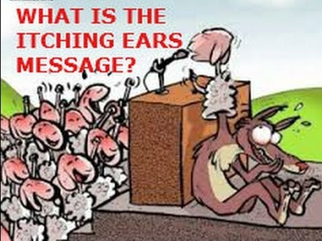
Motivations of False Teachers
False teachers indulge the flesh.
Their focus is not on glorifying God but on their faithless adultery.
They walk after the flesh in the lust of defilement, having “eyes full of adultery.”
Ephesians 2:3 describes such as those that live "in the lusts of our flesh, fulfilling the desires of the flesh and of the mind...."
Their eyes, heart, mind, and focus is on unrighteousness. They are either captured or crave an unrighteous lifestyle.
This often seen in sexual immorality.

Slide 21
Motivations of False Teachers
False teachers indulge the flesh.
The religious world of our country continues to see those teaching in Jesus' name but practice sexual immorality to later be exposed for their immorality.
Sexuality immorality often through pornography is big economic business in the U.S.
The sexuality promiscuity is promoted in media from the internet to television to music lyrics to fill the eyes, ears, and heart of people.

Slide 22
Motivations of False Teachers
False teachers indulge the flesh.
The religious world of our country continues to see those teaching in Jesus' name but There is a focused obsession with sex in American culture. Instead of eyes focused on God, their eyes are focused on the flesh. This is truly dark (Matt 6:22).
At the same time, these false teachers promise freedom and salvation. Yet, there is constant licentious looking.
Perhaps it starts as a look in temptation, but in the end false teachers and their followers are sitting with the scornful as temptation is accepted (Psalms 1, James 1:13-15).
These false teachers do not just allow the birds (temptation to sin) to fly over their head, but instead encourage them to nest on their head.

Slide 23
Motivations of False Teachers
Hamilton in his commentary on 2 Peter expresses the desires and focus of the false teachers by writing:
[As Jesus describes in Matthew 5:28,] In some aspect the desire created by the sense of sight causes them to cast about for an adulteress with whom to cohabit. Moichalis is the term from which adultery is derived and means “adulterous … eyes that are full of (desire for) an adulteress i.e. looking for a woman with whom to commit adultery 2 Pt 2:14 (AG 527). Thayer comments, “eyes always on the watch for an adulteress, or from which adulterous desire beams forth, 2 Pet. ii.14” (416-417). The original text reads literally “having eyes full of an adulteress.” This language is particularly graphic and poignant. When they look at a woman, they view her not as person of value or worth on the basis of moral character but as a possible object of the act of sexual intercourse. What a depraved picture this is! These eyes that are full of an adulteress are also described as that cannot cease from sin.

Slide 24
Motivations of False Teachers
False teachers speak to please the ear of the hearer rather than to profit the soul and glorify God.
False teachers use a false doctrine for serve themselves. They may have a form of godliness yet their heart is carnal.
2 Timothy 3:2-7 describes these false teachers: “For men shall be lovers of their own selves, covetous, boasters, proud, blasphemers, disobedient to parents, unthankful, unholy, 3 Without natural affection, trucebreakers, false accusers, incontinent, fierce, despisers of those that are good, 4 Traitors, heady, highminded, lovers of pleasures more than lovers of God; 5 Having a form of godliness, but denying the power thereof: from such turn away. 6 For of this sort are they which creep into houses, and lead captive silly women laden with sins, led away with divers lusts, 7 Ever learning, and never able to come to the knowledge of the truth.”

Slide 25
Motivations of False Teachers: Differences
The source of the false teacher is not God but their own hearts and lust. Their message is not focused on God but on the self. They bring heresies secretly ("privily" in 2 Peter 2:1 KJV).
Their results are different. The gospel helps one escape the corruption that is in the world through lust and one can become a partaker of God's holy nature (2 Peter 1:4). False teachers promise freedom but leave a person a slave of depravity (2 Peter 2:19).
The character of the true teacher leaves one seeking faith, virtue, knowledge, temperance, self-control, godliness, brotherly kindness, and love (2 Peter 1). False teachers leave one seeking the flesh with eyes of adultery while full of arrogance and greed and despising of authority.
The true teacher appeals to God's word (2 Peter 1:19) while false teacher appeals to lustful desires (2 Peter 2:18).
The true teacher of God's word produces a clear fruit, but the counterfeit teacher is 'like a spring without water (2 Peter 2:17). The counterfeit promise much but deliver enslavement to the flesh.
The end for true teachers of God's word leads to God and His promise of eternal life (1:11), but false teachers lead to destruction (2:1-3).
The difference of false teachers and true teachers of God's word is obvious. They have different sources, results, characters, appeals, fruits, and ends.

Slide 26

Recognizing False Teachers
The child of God must learn to recognize false teachers.
Matthew 7:15-20 teaches we will recognize them by their fruit.
In Jeremiah 23:21-22, false prophet lead people away from God.
False teachers often teach a health and wealth doctrine while whitewashing sin.

Slide 27
Recognizing False Teachers
They revile what they do not understand.
1 Timothy 1:6-7 explains: "From which some having swerved have turned aside unto vain jangling; 7 Desiring to be teachers of the law; understanding neither what they say, nor whereof they affirm." Because they fail to understand, these false teachers engage in controversy and empty words. 1 Timothy 6:3-5 explains: "If any man teach otherwise, and consent not to wholesome words, even the words of our Lord Jesus Christ, and to the doctrine which is according to godliness; 4 He is proud, knowing nothing, but doting about questions and strifes of words, whereof cometh envy, strife, railings, evil surmisings,5 Perverse disputings of men of corrupt minds, and destitute of the truth, supposing that gain is godliness: from such withdraw thyself." 1 Timothy 6:20-21 continues: "O Timothy, keep that which is committed to thy trust, avoiding profane and vain babblings, and oppositions of science falsely so called: 21 Which some professing have erred concerning the faith. Grace be with thee. Amen."
These false teachers are grumblers against God and often employ strife as a form of power to drag down others.

Slide 28

What to Do Regarding False Teachers
False teachers are ultimately in God's hand.
Peter expresses their destruction will be swift with the punishment of unrighteousness.
What can Christians do?
First, Children of God can recognize these false teachers are brute beasts who corrupt themselves (Jude 8-10).

Slide 29
What to Do Regarding False Teachers
Second, Christians can teach God's truth, which triumphs.
Jeremiah 23:28-30 explains, "The prophet that hath a dream, let him tell a dream; and he that hath my word, let him speak my word faithfully. What is the chaff to the wheat? saith the LORD. 29 Is not my word like as a fire? saith the LORD; and like a hammer that breaketh the rock in pieces? 30 Therefore, behold, I am against the prophets, saith the LORD, that steal my words every one from his neighbour."
Lastly, Christians should mark and try to keep false teachers from among the church.
Romans 16:17-18 instructs, "Now I beseech you, brethren, mark them which cause divisions and offences contrary to the doctrine which ye have learned; and avoid them. 18 For they that are such serve not our Lord Jesus Christ, but their own belly; and by good words and fair speeches deceive the hearts of the simple."

Slide 30
Conclusion
Peter warns there will be false teachers even among God's people.
Paul warns the Ephesians elders similarly.
Christ describes their end in Matthew 7:21-23: "Not every one that saith unto me, Lord, Lord, shall enter into the kingdom of heaven; but he that doeth the will of my Father which is in heaven. 22 Many will say to me in that day, Lord, Lord, have we not prophesied in thy name? and in thy name have cast out devils? and in thy name done many wonderful works? 23 And then will I profess unto them, I never knew you: depart from me, ye that work iniquity."

Slide 31
Conclusion
These false teachers have eyes full of adultery and darkness. Thus, children of light need to be aware and endeavor to identify false teachers by doctrine and their fruits.
When possible, Christians should seek to protect the church from false teachers who will lead to destruction.
False teachers act out of impure motivations: popularity, power, money, pride, lust and sensuality to indulge the flesh.
False teachers seek to please the ear of the hearer rather than to profit the soul and glorify God.

Slide 32
Conclusion
The false teacher and true teacher have different sources, results, characters, appeals, fruits, and ends.
Of course, the fact that there is a counterfeit it no reason to reject the true object.
There will be false teachers and hypocrites in the church, but one must not let that adjacent falsehood prevent one from embracing the genuine true teacher of God's word and His people.
God will separate the true and the false in the end (Mt 13:24-30). Christians need to keep their eyes clear and focused on Christ.

